Slide 1

Spotlight

Slide 2
How It Works
PFE is a program that creates opportunities for service, fosters intergenerational friendships, and provides tuition assistance.
Students are paired with an older adult (mentor) in your community
Student and mentor spend time together each week doing various activities
Student and mentor gain a valuable lifelong friendship
Student receives tuition assistance
  K-8 earning potential = $1320 per year
  9-12 earning potential = $1600 per year

Slide 3
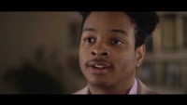
Testimonial Video

Slide 4
How Can the church family help?
Volunteer to be a PFE mentor
Recommend others who might enjoy being a PFE mentor (friend, grandparent, etc.)
Participate in school fundraisers that help with contributing funds for tuition assistance
Check if your local PFE team needs support with the program

Slide 5
PFE Contact Info
School Principal:
Email:
PFE Coordinator:
Email:

